Slide 1
Data Management CT051-3-M
Topic 4 – Data Preprocessing – PART 1

Slide 2
Topic & Structure of Lesson
Need for data preparation
Multidimensional view of data quality
Major tasks in data preprocessing
Data cleaning

Slide 3
Data Preprocessing
Why preprocess the data?
Data cleaning
Data integration
Data transformation

Slide 4
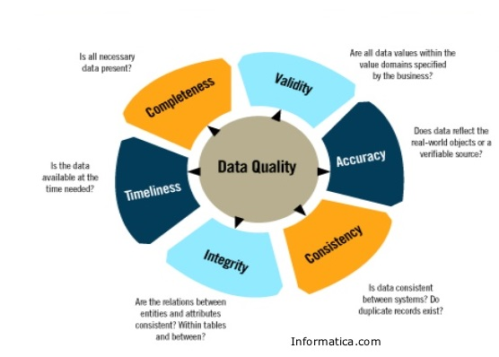
Multi-Dimensional Measure of Data Quality

Slide 5
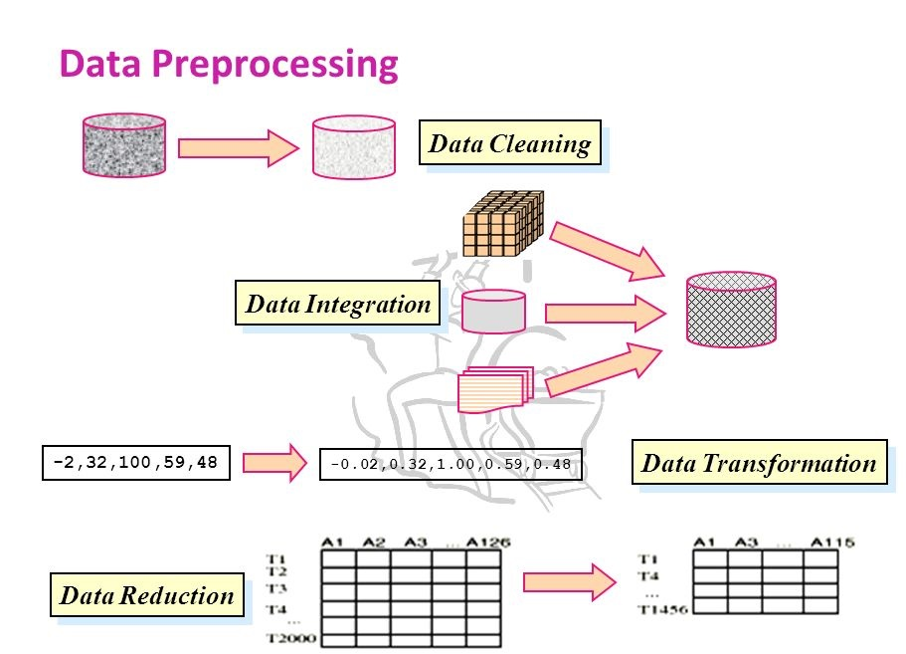
Major Tasks in Data Preprocessing
Fill in missing values, smooth noisy data, identify or remove outliers, and resolve inconsistencies
Integration of multiple databases, data cubes, or files
Normalization, Mean Normalization, Standardization
Duplication

Slide 6
Data Preprocessing
Why preprocess the data?
Data cleaning
Data integration
Data transformation
Summary

Slide 7
Data Cleaning
Data cleaning tasks
Fill in missing values
Identify outliers and smooth out noisy data
Correct inconsistent data

Slide 8
Missing Data
Data is not always available
E.g., many tuples have no recorded value for several attributes, such as customer income in sales data
Missing data may be due to
equipment malfunction
inconsistent with other recorded data and thus deleted
data not entered due to misunderstanding
certain data may not be considered important at the time of entry
not register history or changes of the data

Slide 9
How to Handle Missing Data?
Ignore the tuple (instance): usually done when class label is missing
Fill in the missing value manually: boring + infeasible?
Use a global constant to fill in the missing value: e.g., “unknown”, a new class?!
Use the attribute mean to fill in the missing value
Use the attribute mean for all samples belonging to the same class to fill in the missing value: smarter
Use the most probable value to fill in the missing value

Slide 10
Noisy Data
Noise: random error or variance in a measured variable
Incorrect attribute values may due to
faulty data collection instruments
data entry problems
data transmission problems
technology limitation
inconsistency in naming convention
Other data problems which requires data cleaning
duplicate records
incomplete data
inconsistent data

Slide 11
How to Handle Noisy Data?
Binning method (Quantization):
first sort data and partition into (equi-depth) bins
then one can smooth by bin means, smooth by bin boundaries, etc.
Clustering
detect and remove outliers
Regression
smooth by fitting the data into regression functions
Combined computer and human inspection
detect suspicious values and check by human

Slide 12
Just say age : 10-15 -children
16-20 - teen
21-25 - adults
26-30 - adults
31-40 - adults
41-54 –matured adults
55 above =S C

Slide 13
1. Binning Method

Slide 14
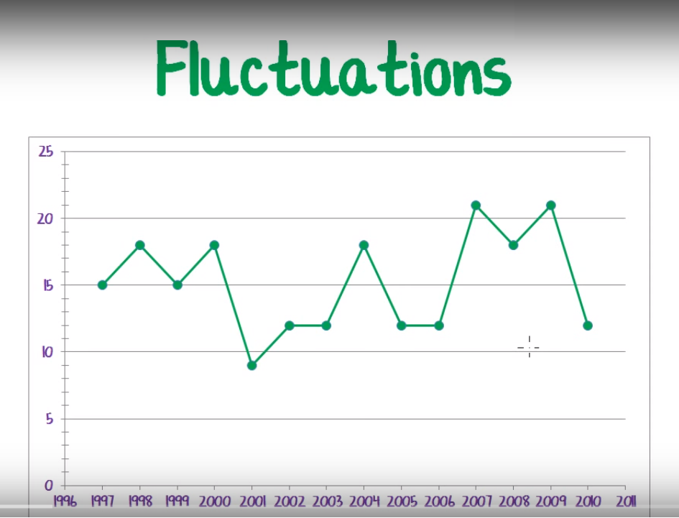
Binning – Data Smoothing
Why do we need data smoothing ?

Slide 15
Binning Method
Equal-depth (frequency) partitioning:
It divides the range into N intervals, each containing approximately same number of samples
Good data scaling

Slide 16
Binning Methods for Data Smoothing
* Sorted data for price (in dollars): 4, 8, 9, 15, 21, 21, 24, 25, 26, 28, 29, 34
* Partition into (equi-depth) bins:
- Bin 1: 4, 8, 9, 15
- Bin 2: 21, 21, 24, 25
- Bin 3: 26, 28, 29, 34
* Smoothing by bin means:
- Bin 1: 9, 9, 9, 9
- Bin 2: 23, 23, 23, 23
- Bin 3: 29, 29, 29, 29
* Smoothing by bin boundaries:
- Bin 1: 4, 4, 4, 15
- Bin 2: 21, 21, 25, 25
- Bin 3: 26, 26, 26, 34

Slide 17
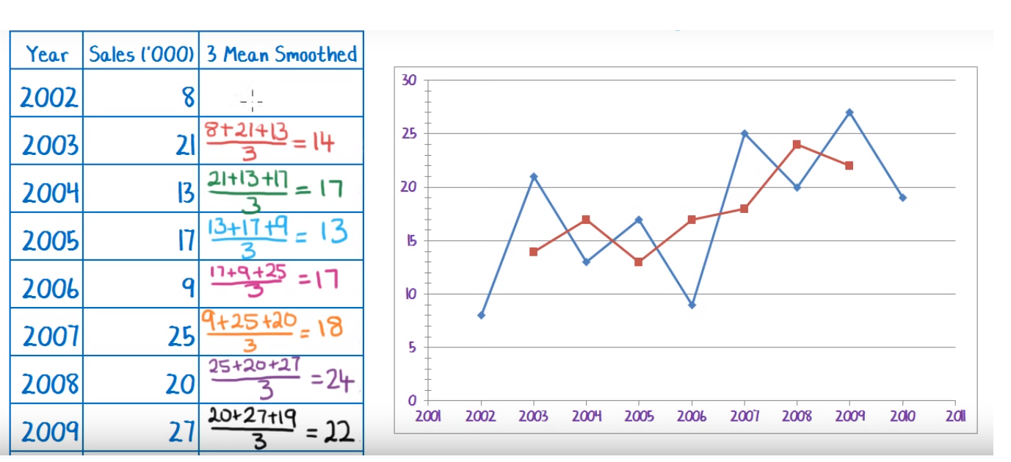
Example: “3 Mean Smoothing”

Slide 18
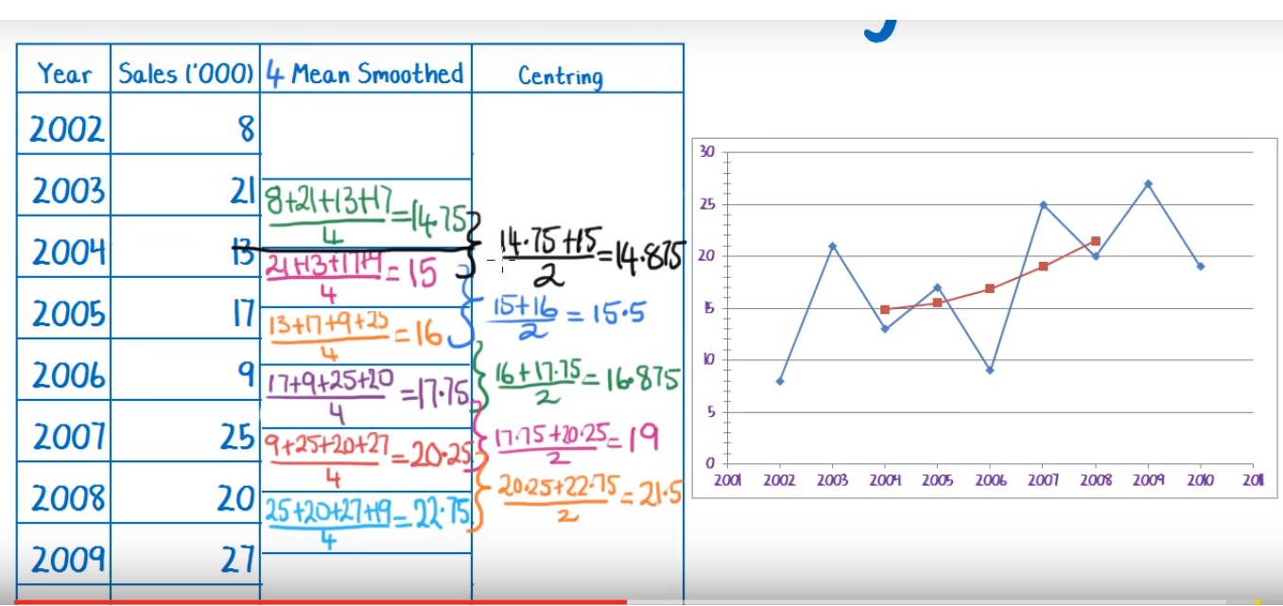
Example: Mean Smoothing - Centering

Slide 19
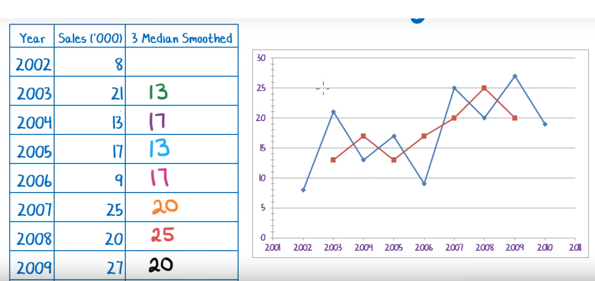
Example: Median Smoothing

Slide 20
2. Clustering

Slide 21
Cluster Analysis
3
A
B
C
2
1

Slide 22
What is Cluster Analysis?
Cluster: a collection of data objects
Similar to one another within the same cluster
Dissimilar to the objects in other clusters
Cluster analysis
Grouping a set of data objects into clusters
Clustering is unsupervised classification: no predefined classes
Typical applications
As a stand-alone tool to get insight into data distribution
As a preprocessing step for other algorithms

Slide 23

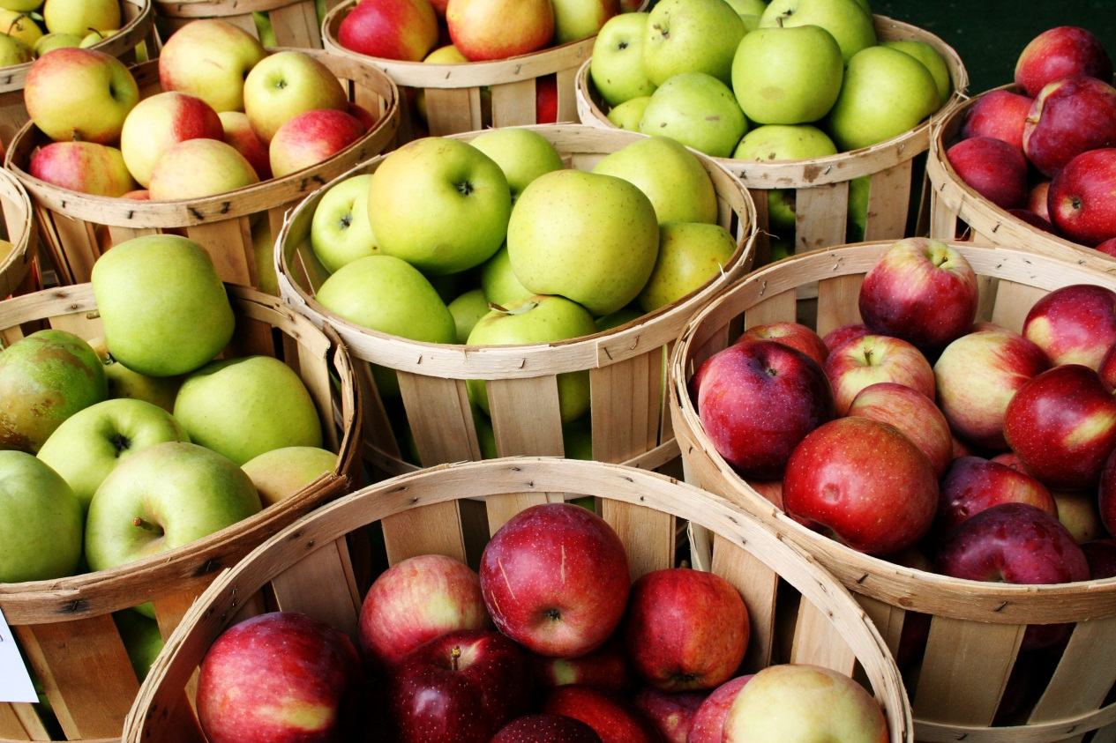

Slide 24
General Applications of Clustering
Pattern Recognition
Spatial Data Analysis
create thematic maps in GIS by clustering feature spaces
detect spatial clusters and explain them in spatial data mining
Image Processing
Economic Science (especially market research)
WWW
Document classification
Cluster Weblog data to discover groups of similar access patterns

Slide 25
What Is Good Clustering?
A good clustering method will produce high quality clusters with
low intra-class similarity (between 2 classes)
high inter-class similarity (within a class)
The quality of a clustering result depends on both the similarity measure used by the method and its implementation.

Slide 26
Typical Requirements of Clustering in Data Mining
Scalability : work good on small sets only
Ability to deal with different types of attributes
Minimal requirements for domain knowledge to determine input parameters
Able to deal with noise and outliers
High dimensionality
Interpretability and usability

Slide 27
Partitioning Algorithms: Basic Concept
Partitioning method: Construct a partition of a database D of n objects into a set of k clusters
Given a k, find a partition of k clusters that optimizes the chosen partitioning condition.
k-means : Each cluster is represented by the center of the cluster.

Slide 28
The K-Means Clustering Method
k-means algorithm is implemented in 5 steps:
Step 1: Ask the user how many clusters k the data set should be partitioned into.
Step 2: Randomly assign k records to be the initial cluster center locations.
Step 3: For each record, find the nearest cluster center. Thus, in a sense, each cluster center “owns” a subset of the records, thereby representing a partition of the data set. We therefore have k clusters, C1,C2, . . . ,Ck .
Step 4: For each of the k clusters, find the cluster centroid, and update the location of each cluster center to the new value of the centroid.
Step 5: Repeat steps 3 to 5 until convergence or termination.

Slide 29
The K-Means Clustering Method
Example

Slide 30
3. Regression

Slide 31
Regression
Dependent variable (y)
Independent variable (x)
Regression is the attempt to explain the variation in a dependent variable using the variation in independent variables.
Regression is thus an explanation of causation.
If the independent variable(s) sufficiently explain the variation in the dependent variable, the model can be used for prediction.

Slide 32
Regression
y
Y1
Y1’
y = x + 1
X1
x

Slide 33
Data Integration and Transformation Next Topic

Slide 34
Question & Answer Session
Q & A

Slide 35
Question & Answer Session
Q & A

